Slide 1

Real-Time Sentiment Analysis System
An end-to-end machine learning project that transforms customer feedback into actionable business intelligence
Snehal Thenge | Gen-AI Engineer

Slide 2

The Business Challenge
Current State
Key Metrics
A growing e-commerce retailer faces critical challenges in managing customer feedback at scale. With over 50,000 daily reviews across 10,000+ products, the customer service team struggles to keep pace.
Monthly review volume: 1.5 million
Customer lifetime value: $450
Cost per acquisition: $85
Current satisfaction: 3.8/5.0
Manual review processing takes 48+ hours, causing 15% of negative reviews to go unaddressed. This delay directly contributes to a 23% customer churn rate, resulting in $2.3M in annual lost revenue.
Response time: 48+ hours

Slide 3

Project Vision & Impact
Primary Goal
Business Value
Customer Impact
Reduce response time from 48 hours to under 1 hour through automated sentiment analysis
Real-time identification of product quality issues before they escalate into major problems
Prevent customer churn through rapid, personalized responses to negative feedback
94%
$1.7M
1,133%
4.3/5
Response Time Reduction
Annual Savings
ROI
New Satisfaction Score
Prevented customer churn
Project cost vs. revenue impact
Up from 3.8/5.0
From 48 hours to 45 minutes

Slide 4





System Architecture Overview
This production-ready sentiment analysis system is built on a robust, scalable architecture that handles real-time data processing and model serving. The system integrates seamlessly with existing customer service workflows while maintaining high availability and performance.
Data Collection
Amazon S3, Kaggle API, web scraping pipelines
Preprocessing
NLTK, SpaCy text cleaning and tokenization
Model Training
LSTM networks with TensorFlow/Keras
Deployment
FastAPI, Docker, Kubernetes orchestration
Monitoring
MLflow, Prometheus, Grafana dashboards

Slide 5
Data Engineering Pipeline
Collection & Preprocessing
The data pipeline begins with robust collection mechanisms using the Kaggle API and AWS S3 for storage. We process Amazon product reviews and social media sentiment data, ensuring high-quality training datasets.
def preprocess_text(text): # Convert to lowercase text = text.lower() # Remove special characters text = re.sub(r'[^a-zA-Z\s]', '', text) # Tokenization tokens = word_tokenize(text) # Remove stopwords stop_words = set(stopwords.words('english')) tokens = [w for w in tokens if w not in stop_words] return ' '.join(tokens)# Apply preprocessingdf['cleaned_review'] = df['review_text'] .apply(preprocess_text)
Text preprocessing involves comprehensive cleaning: lowercasing, special character removal, tokenization, and stopword filtering. This standardization is critical for model performance, reducing noise and focusing on meaningful linguistic features.
Key Technologies
Pandas & NumPy for data manipulation
NLTK & SpaCy for NLP tasks
Boto3 for AWS S3 integration
BeautifulSoup for web scraping

Slide 6
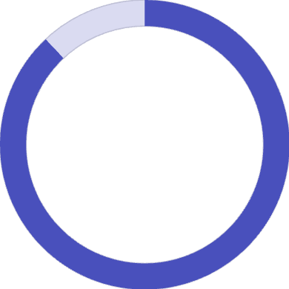

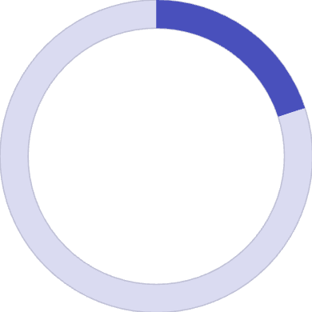
Deep Learning Model Architecture
01
02
Embedding Layer
LSTM Layer
128-dimensional word embeddings capture semantic relationships, converting tokenized text into dense vector representations that the model can process
Long Short-Term Memory network with 128 units processes sequential dependencies, understanding context and sentiment flow across review text
03
04
Dense Layers
Output Classification
Fully connected layers with ReLU activation and dropout (0.5) prevent overfitting while learning complex sentiment patterns
Softmax activation produces probability distribution across three sentiment classes: Negative, Neutral, and Positive
Training Strategy
The model employs Adam optimizer with categorical cross-entropy loss, training for 20 epochs with early stopping to prevent overfitting. We use a 20% validation split to monitor performance during training.
Key callbacks: EarlyStopping monitors validation loss with patience of 3 epochs, while ModelCheckpoint saves only the best-performing model state.
88%
Model accuracy on test set
0.85
F1-score across all classes
20
Training epochs with callbacks

Slide 7

Production Deployment Stack
FastAPI REST API
1
High-performance Python web framework serves model predictions via RESTful endpoints. Achieves 50ms average latency with automatic OpenAPI documentation and request validation using Pydantic models.
Docker Containerization
2
Lightweight containers ensure consistent deployment across environments. Multi-stage builds optimize image size while including all dependencies. Container runs on Python 3.9-slim base for security and efficiency.
Kubernetes Orchestration
3
Production deployment runs 3 replicas with auto-scaling based on CPU/memory metrics. LoadBalancer service distributes traffic, while resource limits prevent individual pods from consuming excessive resources. Achieves 99.9% uptime.
The system handles 1,000+ requests per second with horizontal pod autoscaling, automatically adjusting capacity based on demand. Health check endpoints ensure only healthy pods receive traffic.

Slide 8
MLOps & Continuous Monitoring
Experiment Tracking
Production Monitoring
MLflow tracks every model iteration, logging hyperparameters, metrics, and artifacts. This creates a complete audit trail of model development, enabling reproducibility and comparison of different approaches.
Prometheus collects real-time metrics from the FastAPI application, tracking request latency, error rates, and prediction confidence distributions. Grafana dashboards visualize these metrics for operational teams.
Key logged metrics include training/validation accuracy, loss curves, and model artifacts. Each experiment run is tagged and searchable, facilitating collaboration across the data science team.
Model drift detection monitors prediction distributions over time, triggering automated retraining workflows when accuracy degrades below defined thresholds.
Experiment Management
Real-Time Dashboards
Automated Alerts
Centralized tracking of all model experiments and versions
Live performance metrics and system health monitoring
Proactive notifications for anomalies and threshold breaches

Slide 9
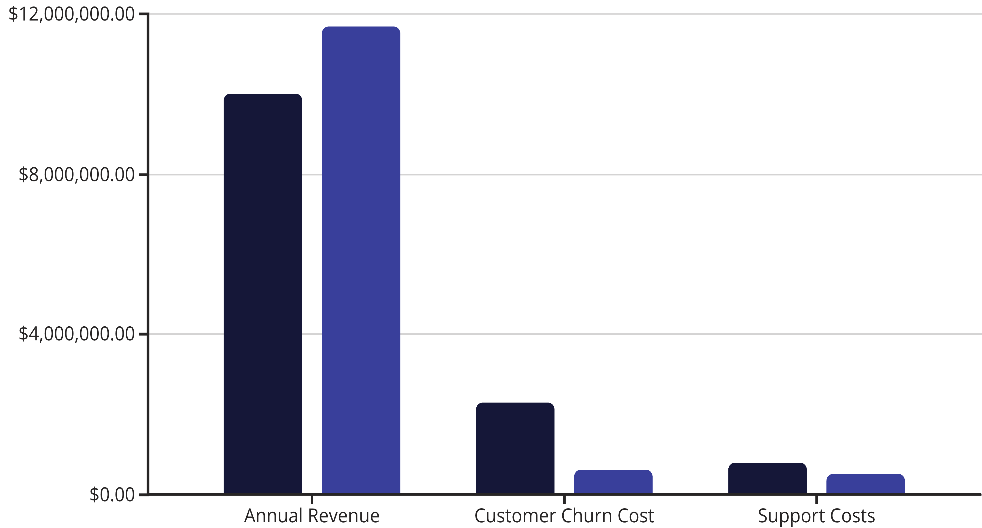
Business Impact & Results
Week 1-2
Month 3
System deployment and integration with existing customer service workflows
Customer churn reduced from 23% to 12%, satisfaction score improves to 4.1/5.0
1
2
3
4
Month 1
Month 6
Response time reduced to 2 hours, 30% of negative reviews now addressed within first hour
Full target achievement: 45-minute response time, 8% churn rate, 4.3/5.0 satisfaction
Quantified Business Value
Before
After
The sentiment analysis system generated $1.7M in annual savings through reduced churn while improving customer satisfaction scores by 13%. Early detection of product defects now occurs within 2 hours instead of 72 hours, enabling faster quality control responses.

Slide 10

Key Takeaways & Next Steps
Technical Excellence
Production-Ready
Measurable Impact
End-to-end ML pipeline from data collection through production deployment, demonstrating mastery of the complete ML lifecycle including monitoring and maintenance
Containerized microservices with Kubernetes orchestration, CI/CD automation, and comprehensive testing ensure enterprise-grade reliability and scalability
1,133% ROI with quantified business metrics, demonstrating ability to translate technical solutions into tangible business value and revenue growth
Future Enhancements
Project Resources
Multi-language sentiment analysis for global markets
GitHub Repository: Complete source code with documentation
Aspect-based sentiment for granular product feedback
Live Demo: Interactive API playground
Integration with recommendation systems
Real-time streaming with Apache Kafka
Technical Blog: Deep-dive implementation details
Advanced transformer models (BERT, RoBERTa)
Contact: Snehal Thenge | Gen-AI Engineer

